Slide 1
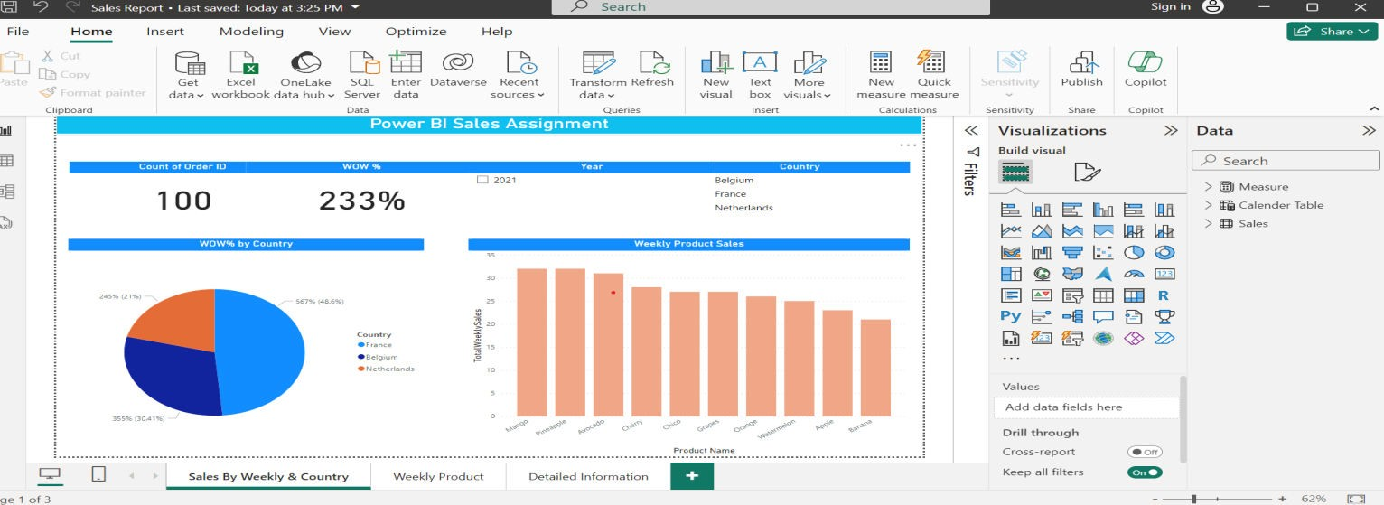
Power BI Assignment Breakdown of Sales Per Country:
Here we found the below mentioned Image for the Breakdown of Sales Per Country and weekly product details.
For above mentioned visual using the below mentioned DAX Quarries for Breakdown of Sales Per Country and weekly product details.
WOW% by Country: to get the wow% using the below mentioned dax
WOW% = DIVIDE(DISTINCTCOUNT(Sales[Order ID])-[LastWeek],[LastWeek]) Selecting the Legend as Country:
Values as WOW%(Week over Week)
Weekly Product Sales: to get the Weekly Product Sales using the below mentioned dax TotalWeeklySales = DISTINCTCOUNT(Sales[Order ID])
axis – Product Name
axis – Total Weekly Sales

Slide 2
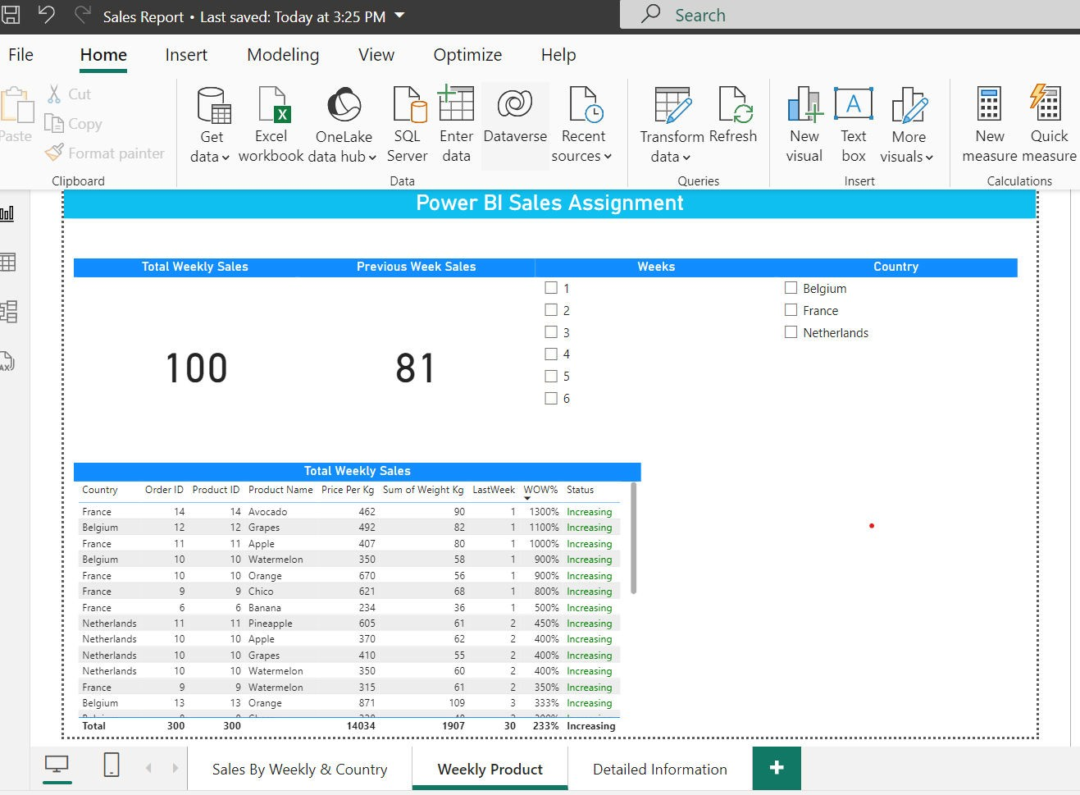
2. volume of products sold weekly and Total weekly sales, including a week-over-week comparison (increasing/decreasing sales).
We can find the Volume of product sold weekly details below mentioned screen shot.
We performed some DAX functions in this visual
LastWeek = CALCULATE(DISTINCTCOUNT(Sales[Order ID]),'Calender Table'[Week] = MAX('Calender Table'[Week])-1)
Status = IF([TotalWeeklySales]>[LastWeek],"Increasing","Decreasing") WOW% = DIVIDE(DISTINCTCOUNT(Sales[Order ID])-[LastWeek],[LastWeek])

Slide 3
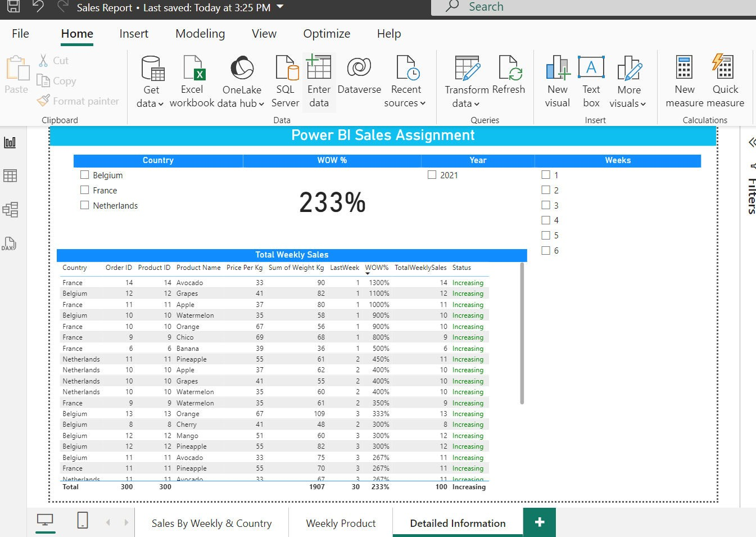
PreviouslyWeeksales = CALCULATE([TotalWeeklySales],DATEADD('Calender Table'[Date],-7,DAY))
By using the above mentioned details we prepared Weekly Product Details.
3. Detailed Information of Each Sales Record
For details information of each sales record we can find in the below mentioned screen shot.
We are using the some of DAX functions in this below mentioned for detailed report.
LastWeek = CALCULATE(DISTINCTCOUNT(Sales[Order ID]),'Calender Table'[Week] = MAX('Calender Table'[Week])-1)
Status = IF([TotalWeeklySales]>[LastWeek],"Increasing","Decreasing") for status measure applied conditional format to change the increasing and decreasing the font colour.
WOW% = DIVIDE(DISTINCTCOUNT(Sales[Order ID])-[LastWeek],[LastWeek]) PreviouslyWeeksales = CALCULATE([TotalWeeklySales],DATEADD('Calender Table'[Date],-7,DAY))

